Slide 1

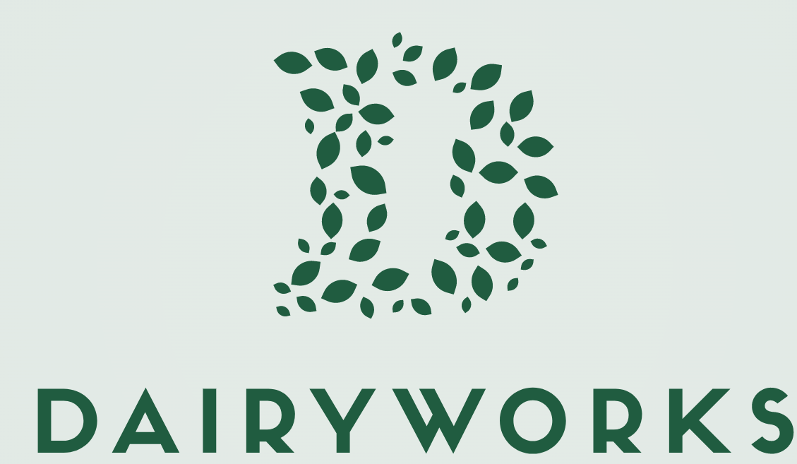
Thrive Bootcamp
Day 2 case study
October 2026

Slide 2
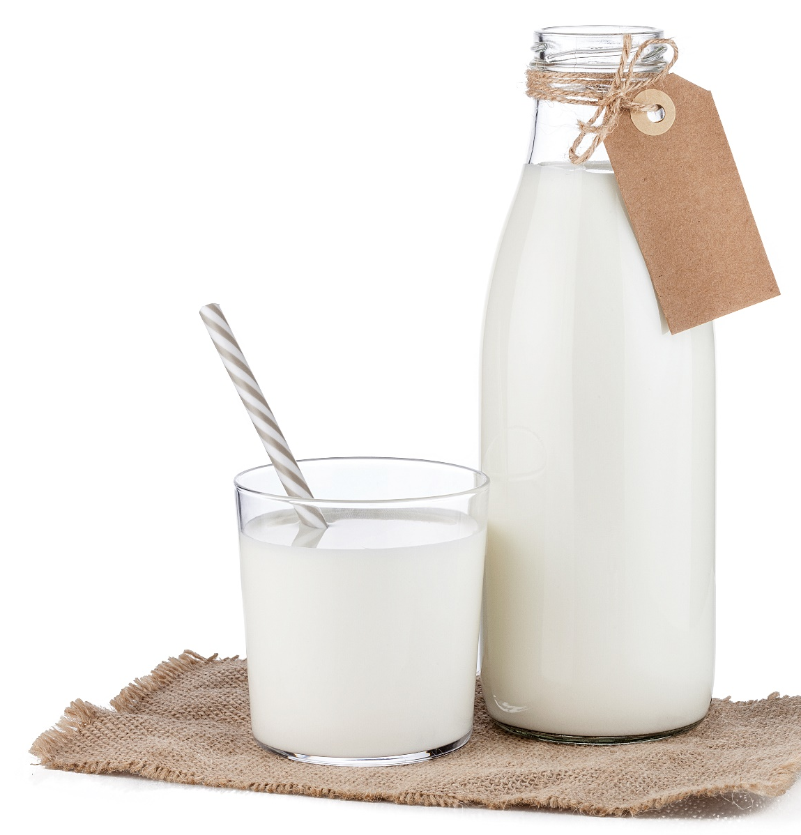
Dairyworks case context
Context
Dairyworks, a UAE-based Dairy company, has appointed a new CEO. Dairyworks has been experiencing declining performance in recent years, so the CEO has hired your team to develop a value creation plan for the next 5 years.
Deliverable to include (in no particular order):
Assessment of the Dairyworks’ current state
  Historical financials
  Brand/product portfolio
  Geographic footprint
  Channel coverage
Market analysis and opportunities
  Dairy market outlook
  Trends and opportunities in Dairy space and/or adjacencies
  Competitive analysis
Value creation plan
  Full potential revenue and EBITDA
  Strategic initiatives for profitability optimization and growth
McKinsey & Company
2

Slide 3
Fact-pack breakdown
Dairyworks’ portfolio and footprint
Dairyworks’ financial performance
Market analysis

Slide 4
Dairyworks introduction
Dairyworks is a UAE-based dairy company founded in 1990
Dairyworks has three primary categories: milk, yogurt, and ice cream
Dairyworks targets the mass consumers
In a 2019 Nielsen survey (n=1000 consumers), an assessment of consumer perception on Dairyworks in the UAE:
Only 1 in every 5 consumers recognized the Dairyworks brand
~60% of consumers that know Dairyworks said that they don’t understand Dairyworks’ brand
Only 1 in every 10 consumers said that they seek out the Dairyworks products

Slide 5
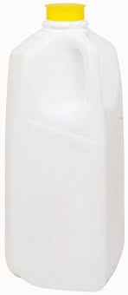
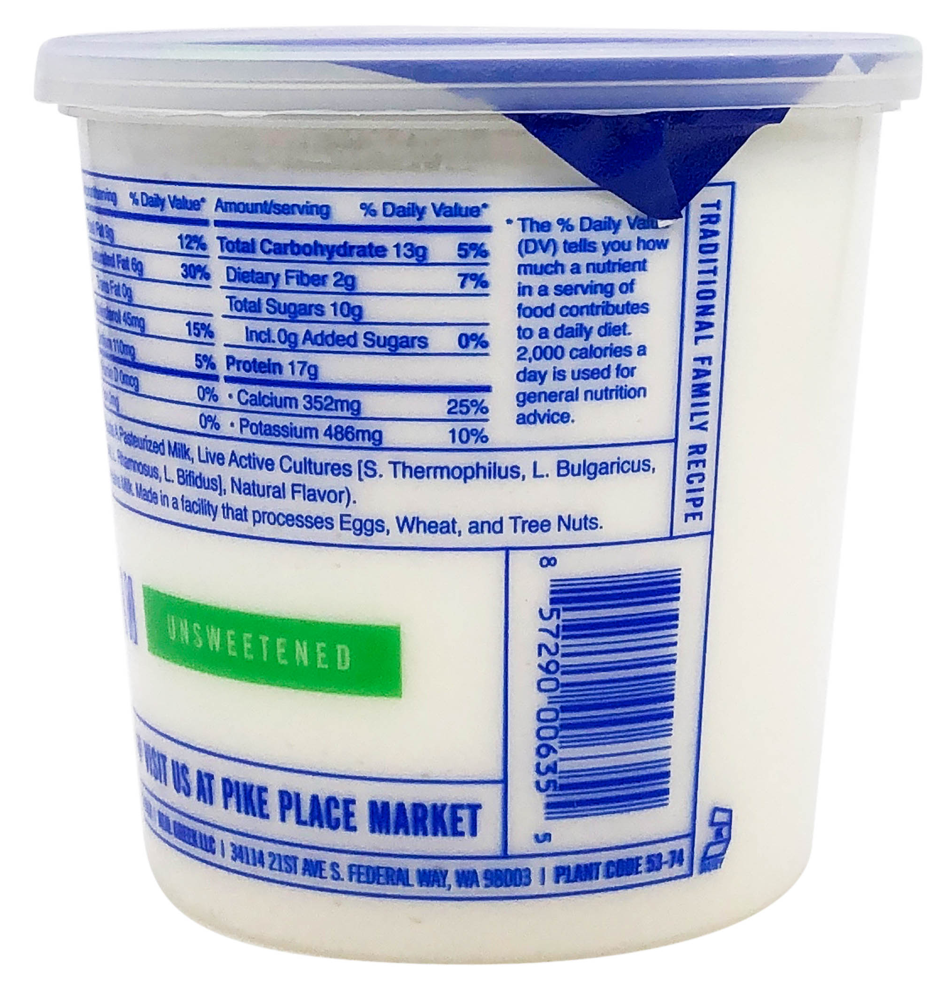

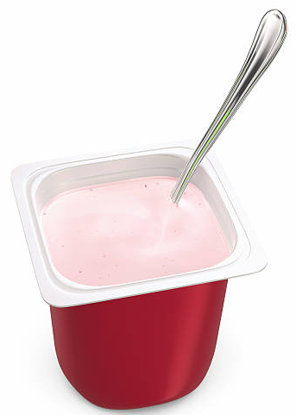
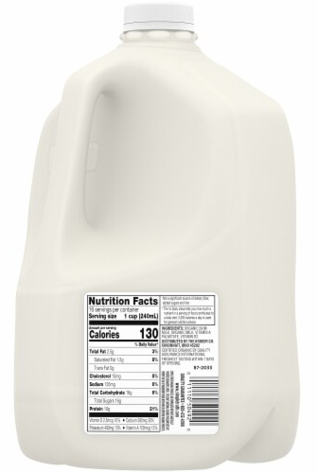
Dairyworks’ product portfolio
Milk products
Yogurt products
Ice cream products
Standard milk, 1 L
4.5 AED
Standard yogurt, 500g
3.5 AED
Ice cream tub, 1L
10 AED
Organic milk, 1L
9 AED
Flavored yogurt, 120g
1.5 AED

Slide 6
Dairyworks’ footprint & channels
Dairyworks’ geographical footprint
Dairyworks’ channel footprint
Manufacturing facilities:
3 in the UAE
Offline:
Modern retail
Traditional retail
20%
COGS is driven by manufacturing efficiency and procurement, where Dairyworks does not leverage economies of scale and has outdated manufacturing facilities
65%
Online
Full basket
Replenishment quick commerce
10%
5%
Distribution network in:
UAE (in-house)
KSA (out-sourced)
Qatar (out-sourced)
Issues in the distribution network span across all three countries

Slide 7
Dairyworks’ market share
In UAE: Almarai Dairy 26%, Dairyworks 15%, Al Rawabi Dairy 7%
In Saudi: Almarai Dairy 40%, NADEC 10%, Danone 7%, …, Dairyworks 2%
In Qatar: Balanda 25%, Ghadeer dairy 12%, Dairyworks 7%

Slide 8
Fact-pack breakdown
Dairyworks’ portfolio and footprint
Dairyworks’ sales and financial performance
Market analysis

Slide 9
Attached – Dairyworks’ SKU sales and gross profit

Slide 10
Attached – Dairyworks’ financials: P&L financials

Slide 11
Fact-pack breakdown
Dairyworks’ portfolio and footprint
Dairyworks’ financial performance
Market analysis

Slide 12
Attached – Peers’ financials: Almarai, SADAFCO, NADEC P&Ls

Slide 13
Attached – Euromonitor data: dairy & ice cream market pricing

Slide 14
How to distribute your time
Task
Time
Aligning with EM on approach and preliminary thinking
09:00 – 10:00 a.m.
Developing a storyline and running analyses
10:00 – 12:30 p.m.
Lunch Break
12:30 – 01:00 p.m.
Building pages and refining analyses
01:00 – 03:30 p.m.
Consolidating and practicing
03:30 – 04:00 p.m.

